Slide 1
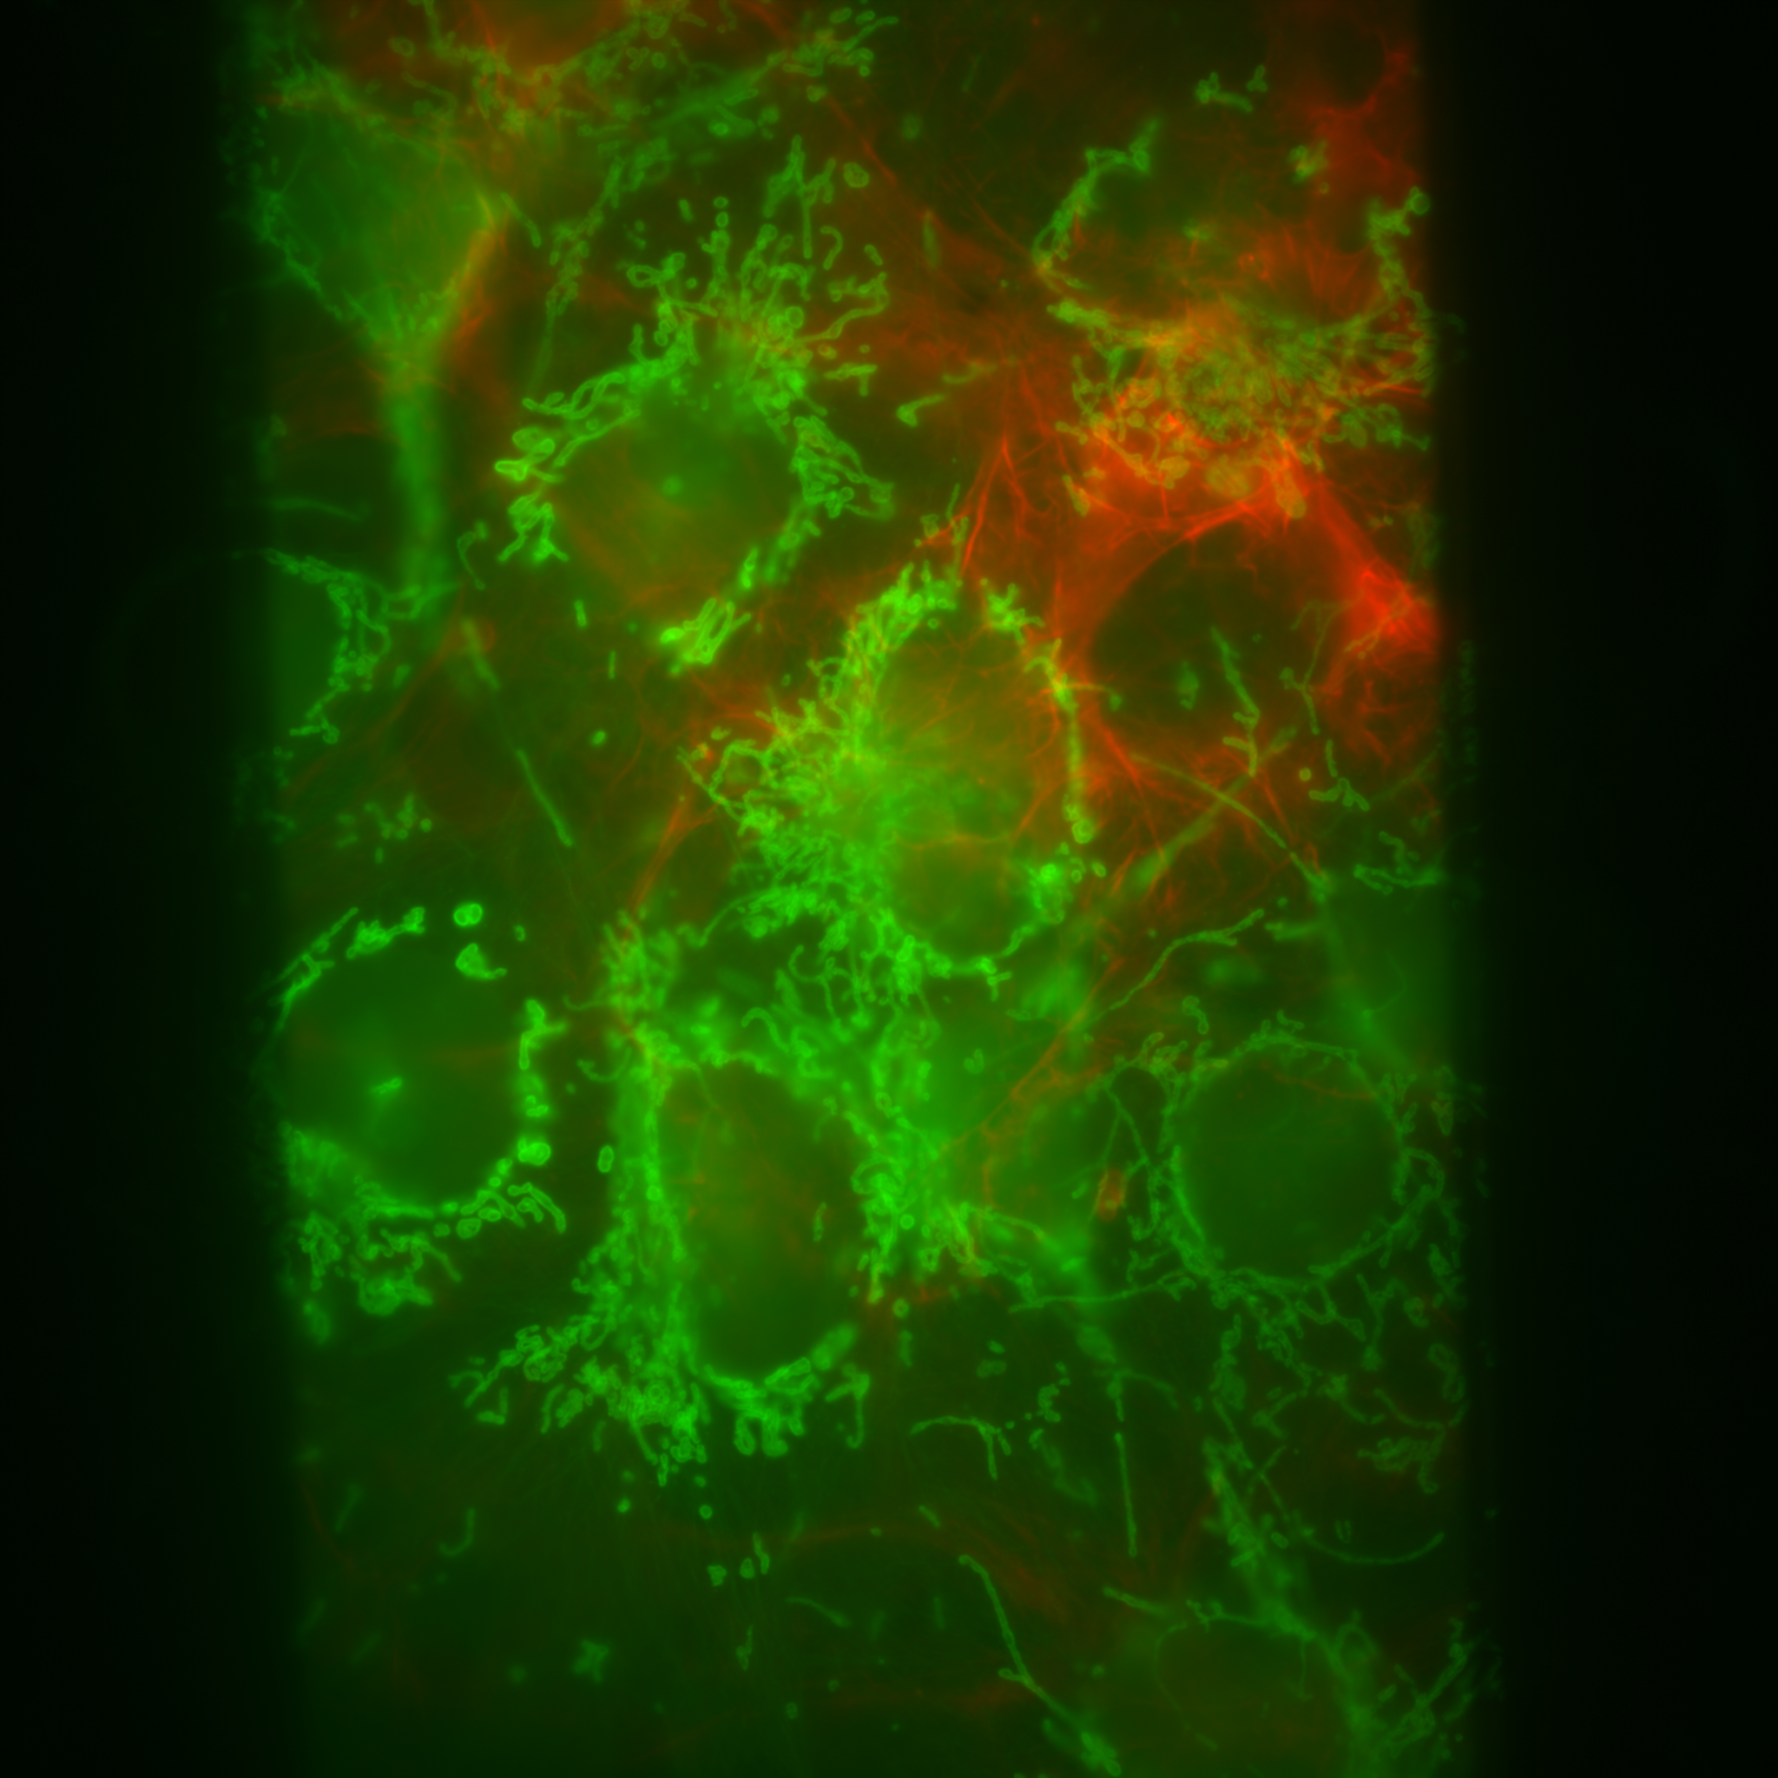
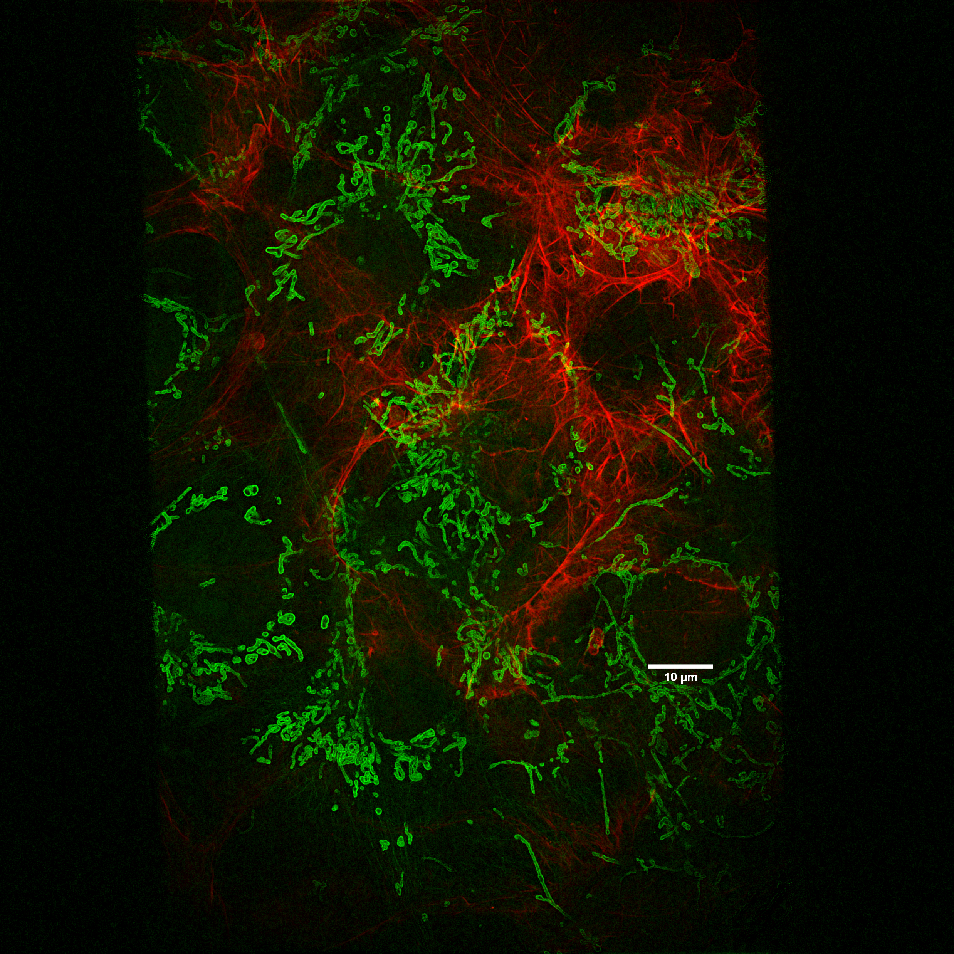
Napari Result 60X

Slide 2
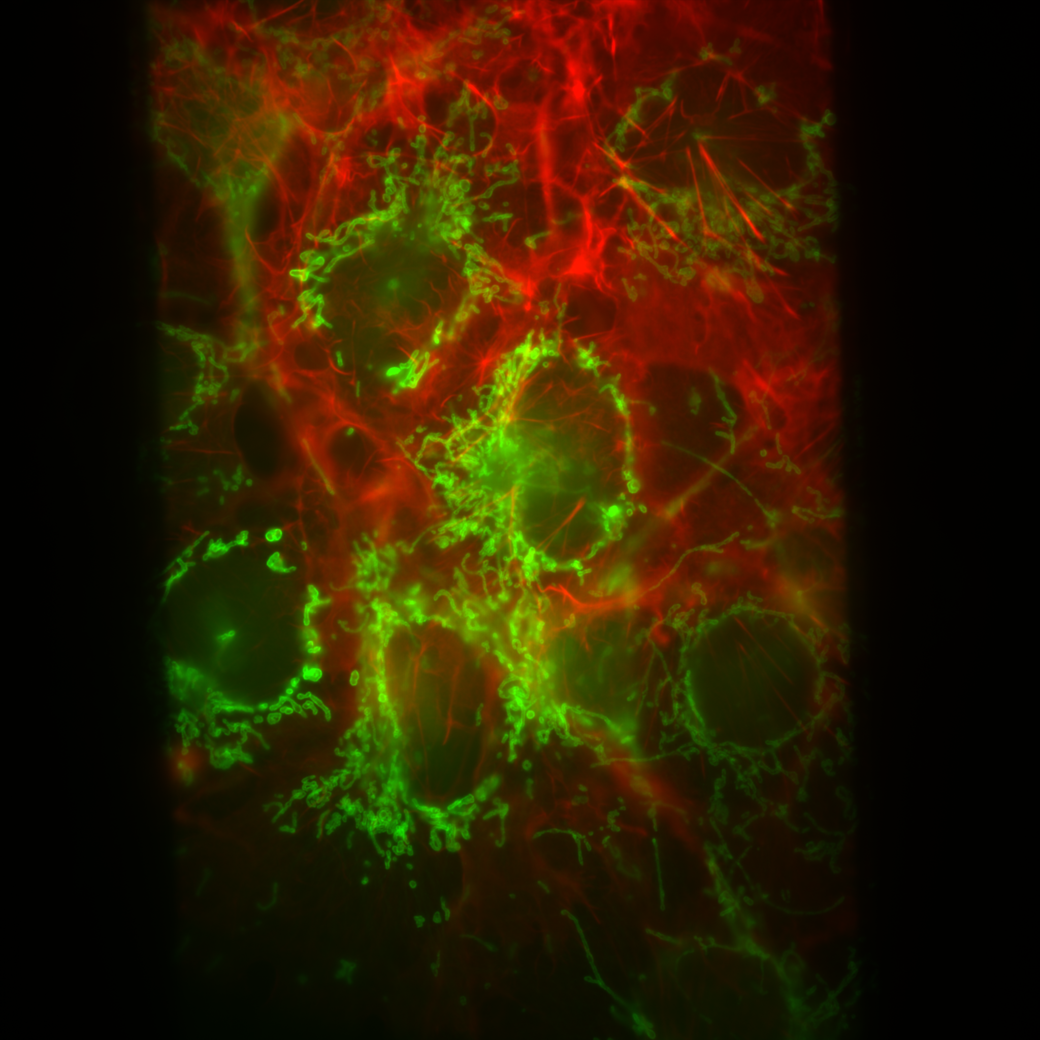
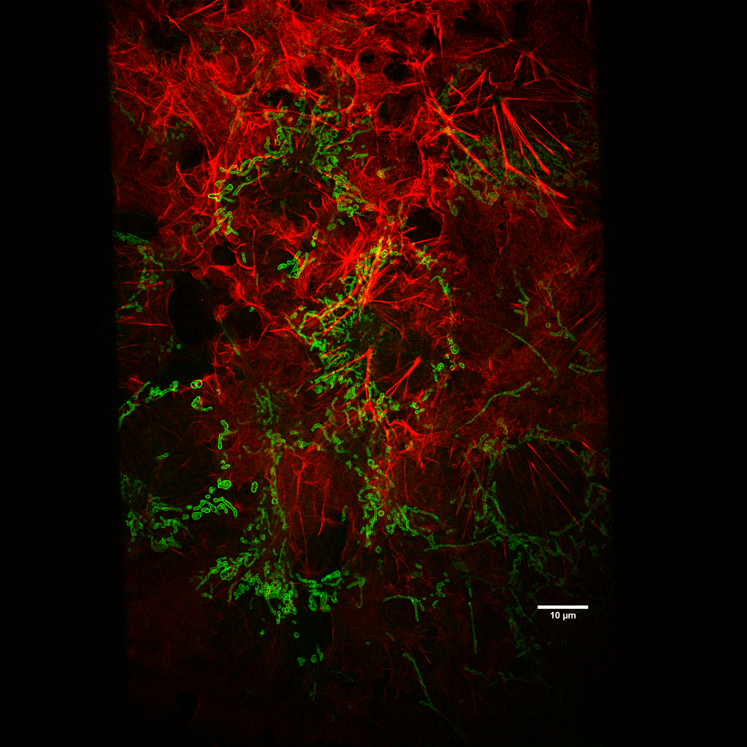
Napari Result Lossless 60X
10 µm
Widefield
Reconstruction

Slide 3
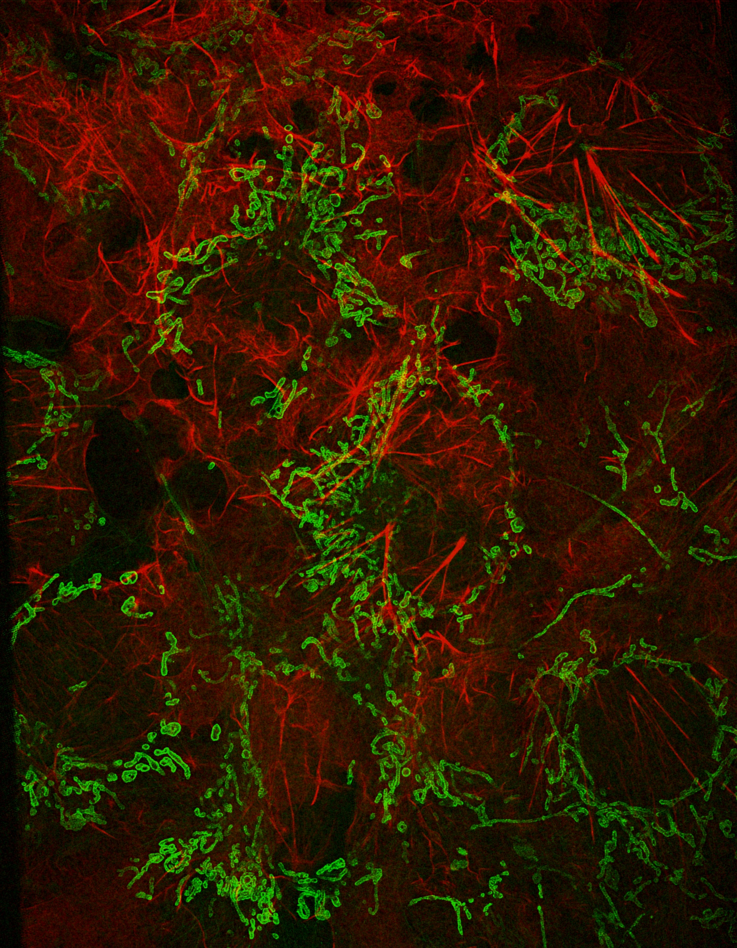
Compression Comparison
10 µm
Lossless
8Bit

Slide 4
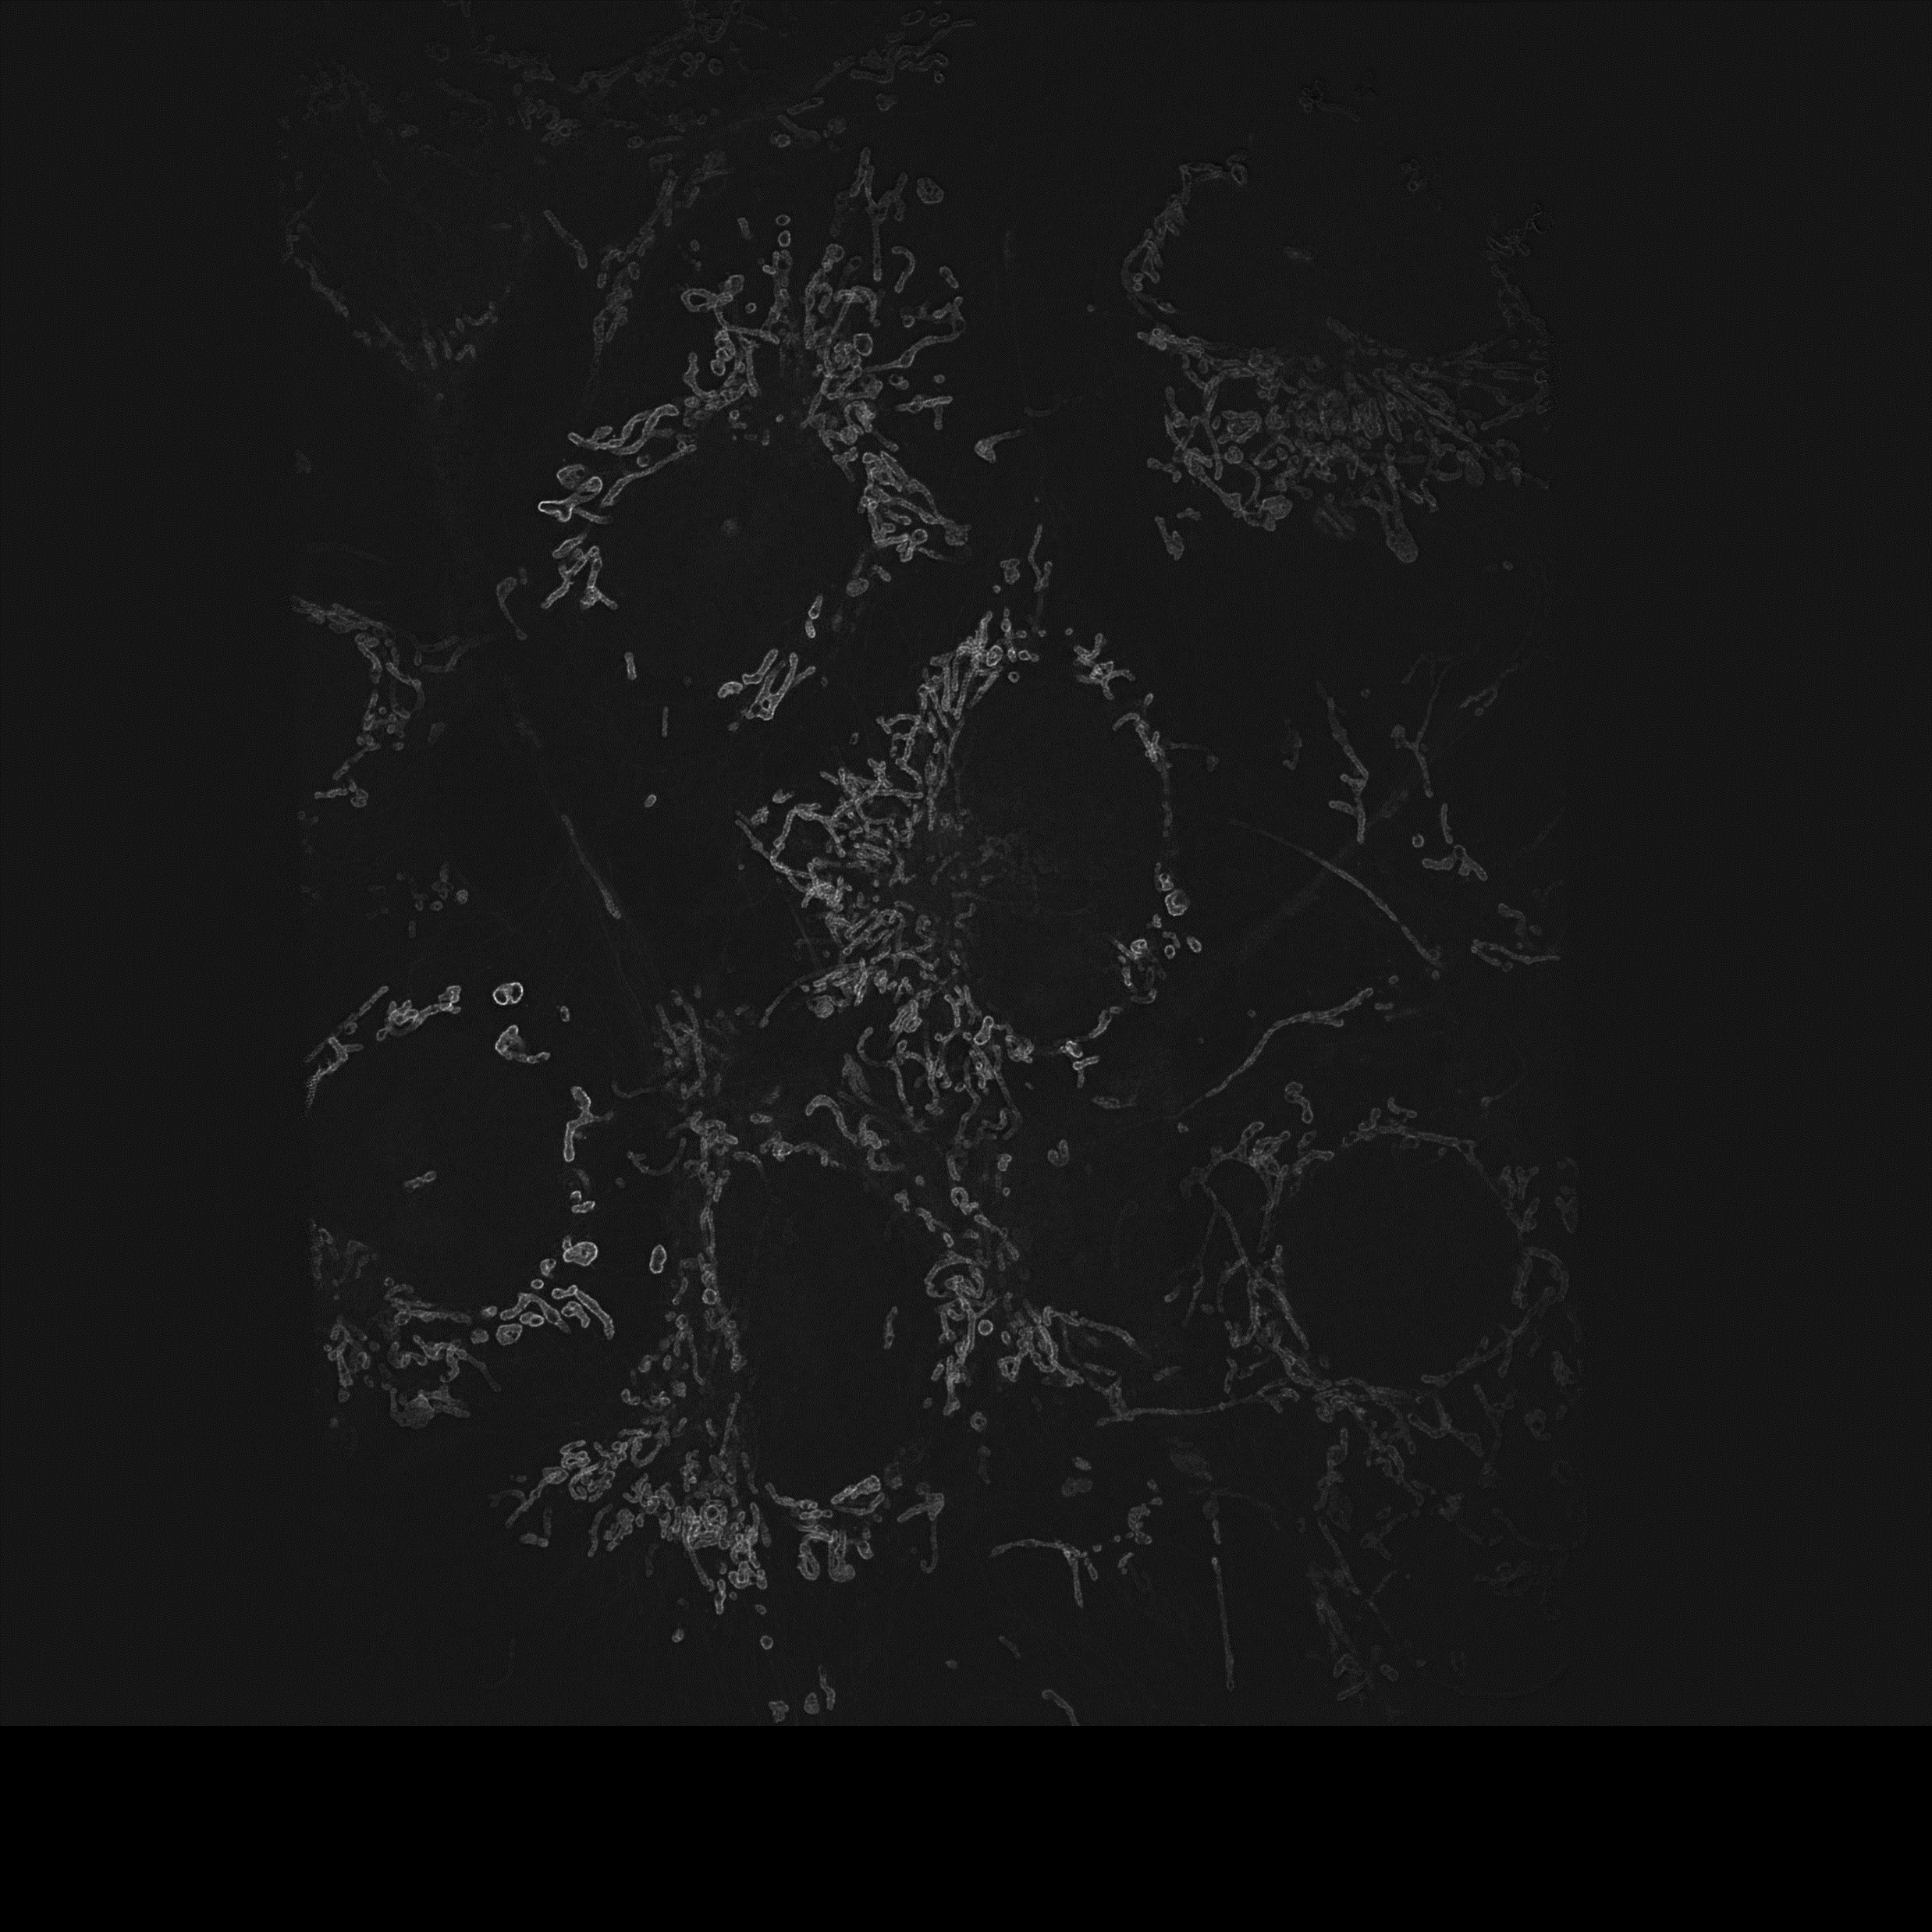
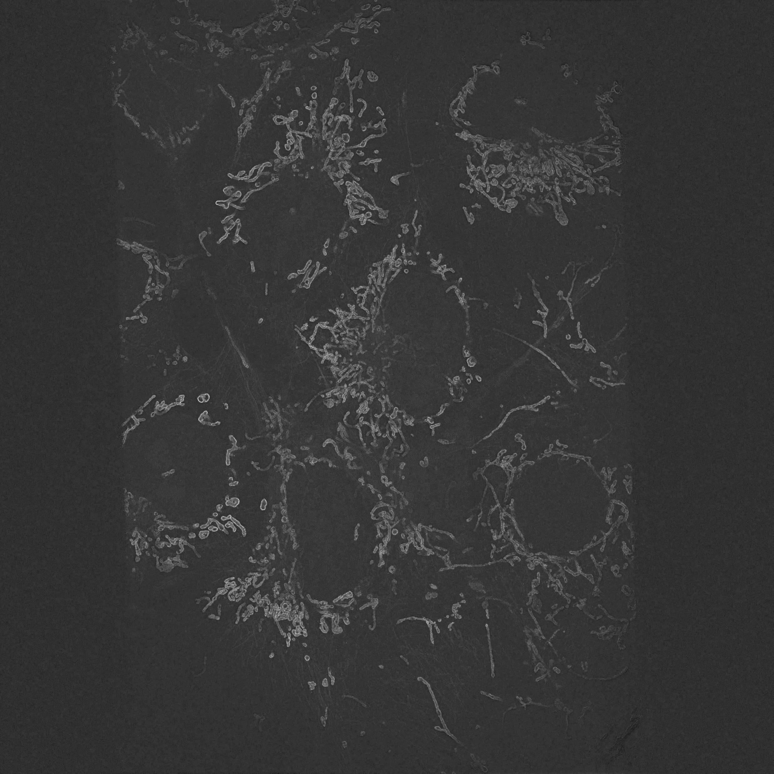
Compression Comparison Crop
Lossless
8Bit

Slide 5
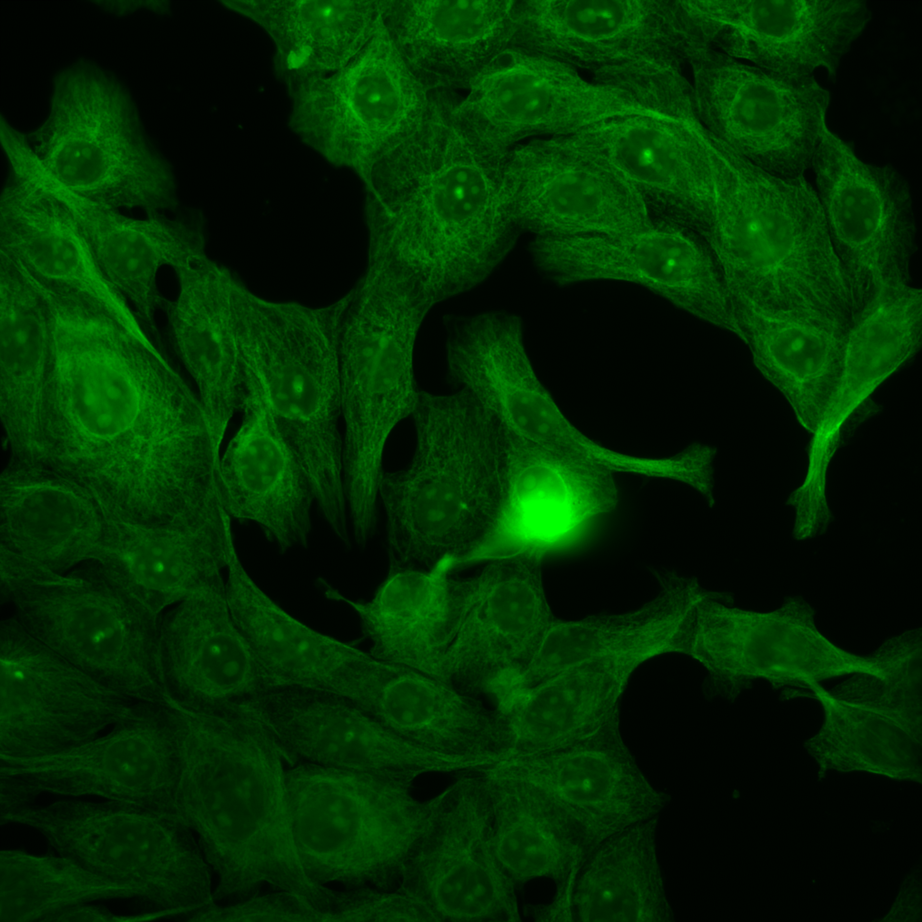
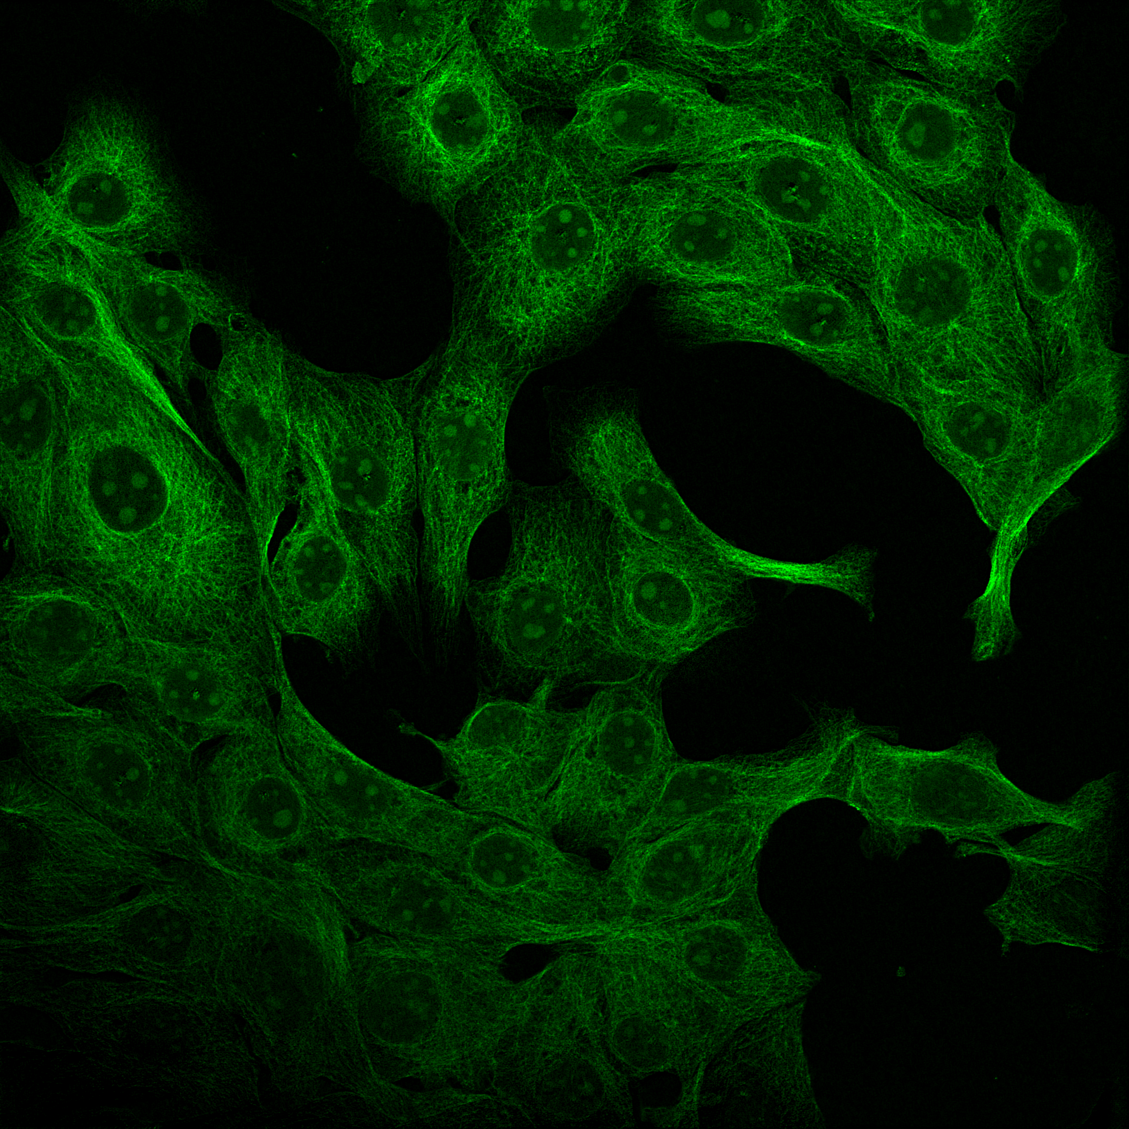
Napari Result Lossless 20X
10 µm
Widefield
Reconstruction

Slide 6
Napari Result Lossless 20X Crop
Widefield
Reconstruction

Slide 7
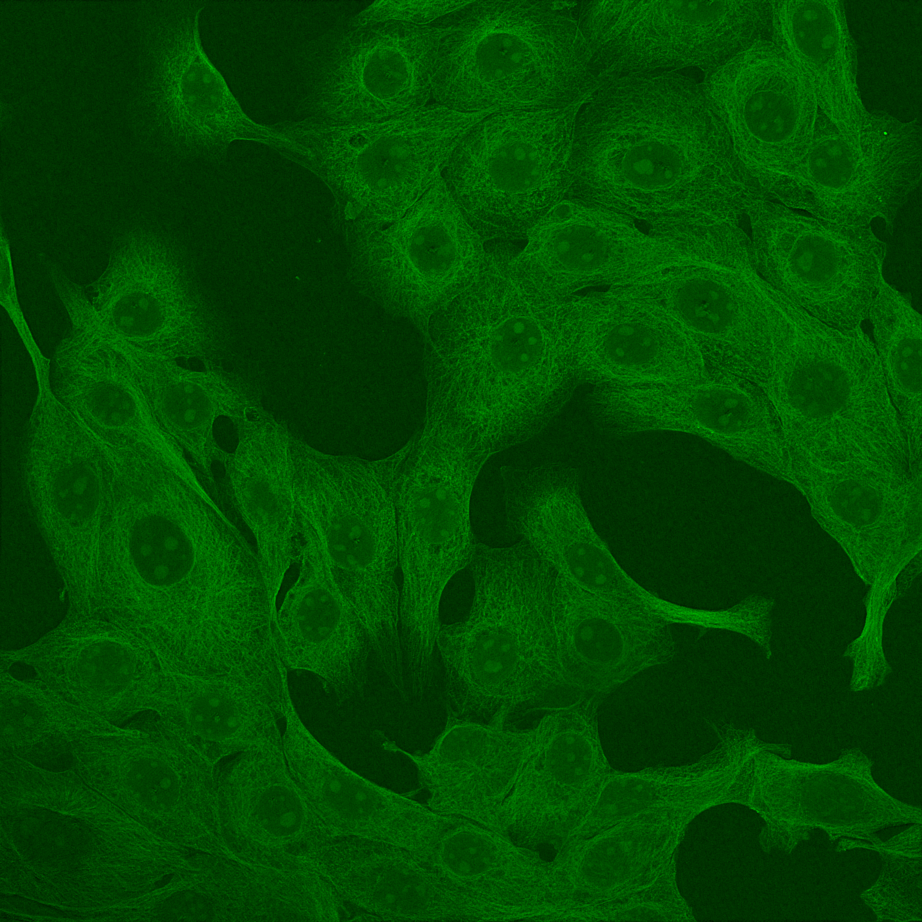
Compression Comparison
Lossless
8Bit

